Slide 1
Project Risk Management

Slide 2
Learning Objectives
Understand what risk is and the importance of good project risk management
Discuss the elements involved in risk management planning and the contents of a risk management plan
List common sources of risks in information technology projects

Slide 3
Learning Objectives (continued)
Describe the risk identification process, tools and techniques to help identify project risks, and the main output of risk identification: a risk register
Discuss the qualitative risk analysis process and explain how to calculate risk factors, create probability/impact matrixes, and apply the Top Ten Risk Item Tracking technique to rank risks

Slide 4
Learning Objectives (continued)
Explain the quantitative risk analysis process and how to apply decision trees, simulation, and sensitivity analysis to quantify risks
Provide examples of using different risk response planning strategies to address both negative and positive risks
Discuss what is involved in risk monitoring and control
Describe how software can assist in project risk management

Slide 5
The Importance of Project Risk Management
Project risk management is the art and science of identifying, analyzing, and responding to risk throughout the life of a project and in the best interests of meeting project objectives
Risk management is often overlooked in projects, but it can help improve project success by helping select good projects, determining project scope, and developing realistic estimates
Unfortunately, crisis management has higher visibility due to the obvious danger to the success of the project but it’s risk management that helps a project have fewer problems to begin with.

Slide 6
Research Shows Need to Improve Project Risk Management
Study by Ibbs and Kwak shows risk has the lowest maturity rating of all knowledge areas
A similar survey was completed with software development companies in Mauritius, South Africa in 2003, and risk management also had the lowest maturity (1.84 vs average of 2.29)
A KLCI Research Group study (2001) shows the benefits of following good software risk management practices
97% had procedures to identify and asess risk
80% identified anticipating and avoiding problems as the primary benefit of risk management
70% had defined s/w development processes
64% has a Project Management Office

Slide 7
Project Management Maturity by Industry Group and Knowledge Area*
KEY: 1 = LOWEST MATURITY RATING 5 = HIGHEST MATURITY RATING
Knowledge Area | Engineering/ Construction | Telecommunications | Information Systems | Hi-Tech Manufacturing
Scope | 3.52 | 3.45 | 3.25 | 3.37
Time | 3.55 | 3.41 | 3.03 | 3.50
Cost | 3.74 | 3.22 | 3.20 | 3.97
Quality | 2.91 | 3.22 | 2.88 | 3.26
Human Resources | 3.18 | 3.20 | 2.93 | 3.18
Communications | 3.53 | 3.53 | 3.21 | 3.48
Risk | 2.93 | 2.87 | 2.75 | 2.76
Procurement | 3.33 | 3.01 | 2.91 | 3.33
*Ibbs, C. William and Young Hoon Kwak. “Assessing Project Management Maturity,”
Project Management Journal (March 2000).

Slide 8
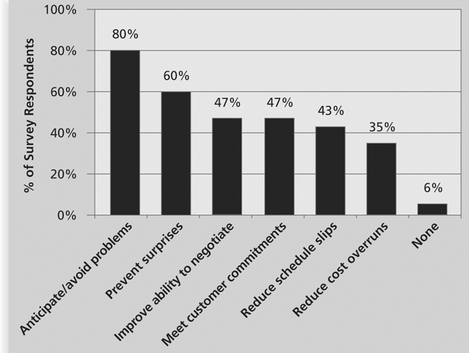
Benefits from Software Risk Management Practices*
*Kulik, Peter and Catherine Weber, “Software Risk Management Practices – 2001,” KLCI Research Group (August 2001).

Slide 9
Negative Risk
A dictionary definition of risk is “the possibility of loss or injury”
Negative risk involves understanding potential problems that might occur in the project and how they might impede project success
Negative risk management is like a form of insurance; it is an investment
If IT projects are so risky, why do companies pursue them?

Slide 10
Risk Can Be Positive
Positive risks are risks that result in good things happening; sometimes called opportunities
A general definition of project risk is an uncertainty that can have a negative or positive effect on meeting project objectives
The goal of project risk management is to minimize potential negative risks while maximizing potential positive risks
Information Technology Project Management, Fifth Edition, Copyright 2007

Slide 11
Best Practice
Some organizations make the mistake of only addressing tactical and negative risks when performing project risk management
David Hillson (www.risk-doctor.com) suggests overcoming this problem by widening the scope of risk management to encompass both strategic risks and upside opportunities, which he refers to as integrated risk management
Ensure that project delivery is tied to organizational needs and vision
Allowing an appropriate level of risk to be taken intelligently with full awareness of the degree of uncertainty and its potential effects on objectives

Slide 12
Risk Utility
Different organizations and people have different tolerances for risk
Risk utility or risk tolerance is the amount of satisfaction or pleasure received from a potential payoff
Utility rises at a decreasing rate for people who are risk-averse
Those who are risk-seeking have a higher tolerance for risk and their satisfaction increases when more payoff is at stake
The risk-neutral approach achieves a balance between risk and payoff

Slide 13
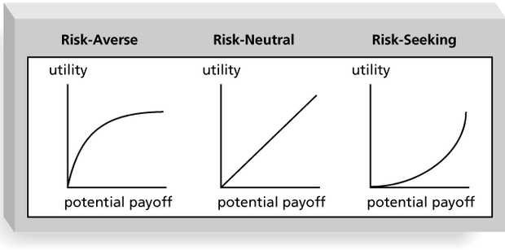
Risk Utility Function and Risk Preference

Slide 14
Project Risk Management Processes
Risk management planning: deciding how to approach and plan the risk management activities for the project
Risk identification: determining which risks are likely to affect a project and documenting the characteristics of each
Qualitative risk analysis: prioritizing risks based on their probability and impact of occurrence

Slide 15
Project Risk Management Processes
Quantitative risk analysis: numerically estimating the effects of risks on project objectives
Risk response planning: taking steps to enhance opportunities and reduce threats to meeting project objectives
Risk monitoring and control: monitoring identified and residual risks, identifying new risks, carrying out risk response plans, and evaluating the effectiveness of risk strategies throughout the life of the project

Slide 16
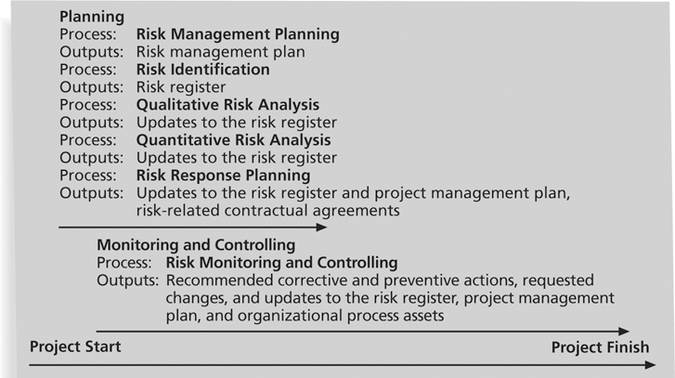
Project Risk Management Summary

Slide 17
Risk Management Planning
The main output of risk management planning is a risk management plan—a plan that documents the procedures for managing risk throughout a project
The project team should review project documents, corporate risk management policies, lessons-learned reports from past projects and understand the organization’s and the sponsor’s approaches to risk
Important to clarify roles and responsibilities, prepare budget and schedule estimates for risk-related work and identify risk categories for consideration
The level of detail will vary with the needs of the project

Slide 18
Topics Addressed in a Risk Management Plan
Methodology: How will risk management be performed on this project? What tools and data sources are available and applicable?
Roles and Responsibilities: Who are the individuals responsible for implementing specific tasks and providing deliverables related to risk management?
Budget and Schedule: What are the estimated costs and schedules for performing risk-related activities?
Risk Categories: What are the main categories of risks that should be addressed on this project? Is there a risk breakdown structure for the project?
Risk Probability and Impact: How will the probabilities and impacts of risk items be assessed? What scoring and interpretation methods will be used for the qualitative and quantitative analysis of risks?
Risk Documentation: What reporting formats and processes will be used for risk management activities?

Slide 19
Contingency and Fallback Plans, Contingency Reserves
In addition to a risk management plan, many projects also include:
Contingency plans – predefined actions that the project team will take if an identified risk event occurs
Expecting new release of a s/w package, must plan to use older version if delayed
Fallback plans - developed for risks that have a high impact on meeting project objectives, and are put into effect if attempts to reduce the risk are not effective
College grad has main plan and contingency plans of where to live after graduation but needs fallback plan to possibly live at home
Contingency reserves or allowances - provisions held by the project sponsor or organization to reduce the risk of cost or schedule overruns to an acceptable level
Project falling behind schedule due to inexperience with new technology, use these funds to hire outside trainer

Slide 20
Common Sources of Risk in Information Technology Projects
Several studies show that IT projects share some common sources of risk
The Standish Group developed an IT success potential scoring sheet (next slide) based on potential risks
If a potential project does not receive a minimum score, the organization might decide not to work on it or to take actions to reduce the risks before it invests too much time or money
The Standish Group developed specific questions for each success criterion to help decide the number of points to assign to a project
User Involvement: Do I have the right users? Did I involve the users early on? Do I make involvement easy? …

Slide 21
Information Technology Success Potential Scoring Sheet
The number of questions corresponding to each success criterion determines the number of points each positive response is assigned
Ex: User involvement: 19/5 (or 3.8) points per question answered positively

Slide 22
Broad Categories of Risk
Many organizations develop their own risk questionnaires. Some of the categories of risk might include:
Market risk – Will the new service or product be useful to the organization or marketable to others? Will the users accept it? Will someone else create a better product?
Financial risk – can the organization afford to undertake the project? Will the project meet NPV, ROI and payback estimates?
Technology risk – is the project technically feasible? Is it leading edge or bleeding edge technology?
People risk – Are people with appropriate skills available to help complete the project? Does senior management support the project?
Structure/process risk – What is the degree of change the new project will introduce into user areas and business procedures? With how many other systems does a new project/system need to interact?

Slide 23
What Went Wrong?
KPMG, a large consulting firm, published a study in 1995 that found that 55 percent of runaway projects—projects that have significant cost or schedule overruns—did no risk management at all; 38 percent did some (but half did not use their risk findings after the project was underway); and 7 percent did not know whether they did risk management or not
The timing of risk management is also an important consideration
Comair delayed replacing a legacy system that managed flight crews and, when it eventually crashed over the holidays, 3,900 flights were cancelled, 200,000 passengers were stranded and ran up a tab of $20 million.

Slide 24
Risk Breakdown Structure
A risk breakdown structure is a hierarchy of potential risk categories for a project
Similar to a work breakdown structure but used to identify and categorize risks
In addition to identifying risk based on the nature of the project or products produced, it is also important to identify potential risks according to project management knowledge areas

Slide 25
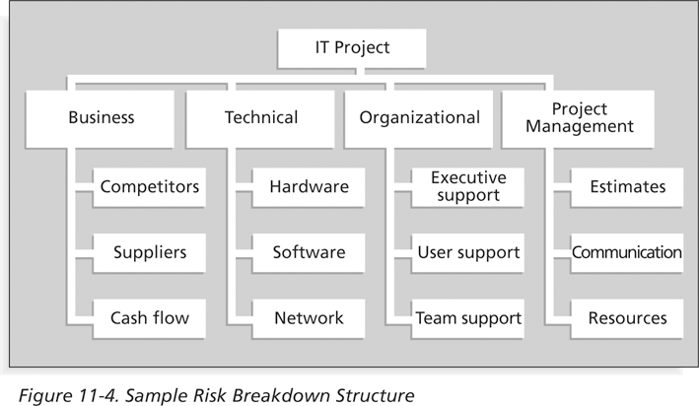
Sample Risk Breakdown Structure

Slide 26
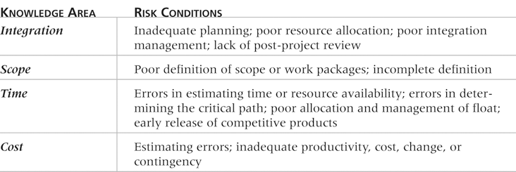
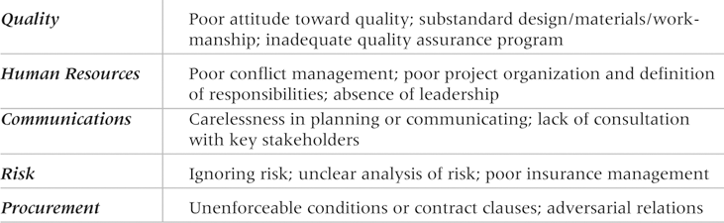
Potential Negative Risk Conditions Associated With Each Knowledge Area

Slide 27
Risk Identification
Risk identification is the process of understanding what potential events might hurt or enhance a particular project
This is an ongoing process throughout the project lifecycle as things change
You can not manage risks that you don’t identify
Risk identification tools and techniques include:
Brainstorming
The Delphi Technique
Interviewing
SWOT analysis

Slide 28
Brainstorming
Brainstorming is a technique by which a group attempts to generate ideas or find a solution for a specific problem by amassing ideas spontaneously and without judgment
An experienced facilitator should run the brainstorming session
Be careful not to overuse or misuse brainstorming
Psychology literature shows that individuals produce a greater number of ideas working alone than they do through brainstorming in small, face-to-face groups
Group effects often inhibit idea generation

Slide 29
Delphi Technique
The Delphi Technique is used to derive a consensus among a panel of experts who make predictions about future developments
Developed by the RAND Corporation for the US Air Force in the late 1960s
Provides independent and anonymous input regarding future events
Uses repeated rounds of questioning and written responses and avoids the biasing effects possible in oral methods, such as brainstorming
Requires a panel of experts for the particular area in question

Slide 30
Interviewing
Interviewing is a fact-finding technique for collecting information in face-to-face, phone, e-mail, or instant-messaging discussions
Useful to have a prepared set of questions as a guide to the interview
Interviewing people with similar project experience is an important tool for identifying potential risks

Slide 31
SWOT Analysis
SWOT analysis (strengths, weaknesses, opportunities, and threats) can also be used during risk identification
Project teams focus on the broad perspectives of potential risks for particular projects
What are the company’s strengths and weaknesses related to this project
What opportunities and threats exist
Helps identify the broad negative and positive risks that apply to a project

Slide 32
Other Risk Identification Methods
Checklists based on risks encountered in previous projects
Analyze the validity of project assumptions as incomplete, inaccurate and/or inconsistent assumptions can lead to identifying more risks
Diagramming techniques: cause-and-effect, fishbone, flowcharts and influence diagrams
Influence diagrams represent decision problems by displaying essential elements, including decisions, uncertainties, causality and objectives and how they influence each other (www.lumina.com/software/influencediagrams.html)

Slide 33
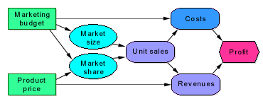
Other Risk Identification Methods
An influence diagram is a simple visual representation of a decision problem. Influence diagrams offer an intuitive way to identify and display the essential elements, including decisions, uncertainties, and objectives, and how they influence each other.
This simple influence diagram shows how decisions about the marketing budget and product price influence expectations about its uncertain market size and market share. These, in turn, influence costs and revenues, which affect the overall profit.
The product manager, VP of marketing, and market analyst may work together to draw such a diagram to develop a shared understanding of the key issues. The diagram provides a high-level qualitative view under which the analyst builds a detailed quantitative model.

Slide 34





Other Risk Identification Methods
 |  | A decision is a variable that you, as the decision maker, have the power to control.
 |  | A chance variable is uncertain and you cannot control it directly.
 |  | An objective variable is a quantitative criterion that you are trying to maximize (or minimize).
 |  | A general variable is a deterministic function of the quantities it depends on. An arrow denotes an influence. A influences B means that knowing A would directly affect our belief or expectation about the value of B. An influence expresses knowledge about relevance. It does not necessarily imply a causal relation, or a flow of material, data, or money.

Slide 35
Risk Register
The main output of the risk identification process is a list of identified risks and other information needed to begin creating a risk register
A risk register is:
A document that contains the results of various risk management processes and that is often displayed in a table or spreadsheet format
A tool for documenting potential risk events and related information
Risk events refer to specific, uncertain events that may occur to the detriment or enhancement of the project
Negative risks: delays in completing work as scheduled, increases in estimated costs, supply shortages, litigation, strikes, etc.
Positive risks: completing work sooner and/or cheaper than planned, collaborating with suppliers to produce better products, good publicity, etc.

Slide 36
Risk Register Contents
An identification number for each risk event
A rank for each risk event
The name of each risk event
A description of each risk event
The category under which each risk event falls
The root cause of each risk

Slide 37
Risk Register Contents (continued)
Triggers for each risk; triggers are indicators or symptoms of actual risk events
Cost overruns on early activities, defective products
Potential responses to each risk
The risk owner or person who will own or take responsibility for each risk
The probability and impact of each risk occurring
The status of each risk

Slide 38
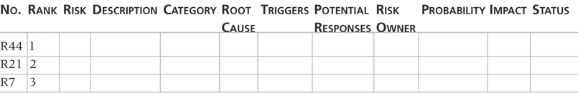
Sample Risk Register

Slide 39
Qualitative Risk Analysis
After identifying risks, the next step is to understand which risks are most important
Assess the likelihood and impact of identified risks to determine their magnitude and priority
Risk quantification tools and techniques include:
Probability/impact matrixes
The Top Ten Risk Item Tracking
Expert judgment

Slide 40
Probability/Impact Matrix
A probability/impact matrix or chart lists the relative probability of a risk occurring on one side of a matrix or axis on a chart and the relative impact of the risk occurring on the other
List the risks and then label each one as high, medium, or low in terms of its probability of occurrence and its impact if it did occur
Deal first with those risks in the high probability/high impact cell

Slide 41
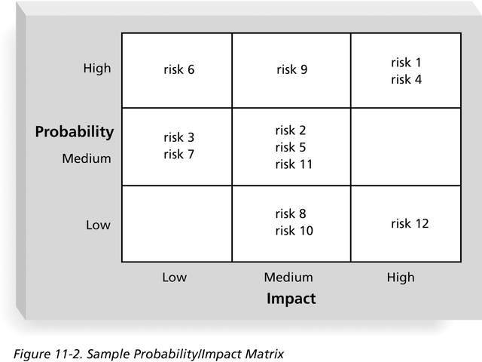
Sample Probability/Impact Matrix

Slide 42
Risk factors
Can also calculate risk factors
Numbers that represent the overall risk of specific events based on their probability of occurring and the consequences to the project if they do occur
Probabilities of a risk occurring can be estimated based on several factors based on the unique nature of each project
For example: technology not being mature, technology too complex, inadequate support base for developing the technology
The impact of a risk could include factors such as the availability of fallback solutions or the consequences of not meeting performance, cost and schedule estimates

Slide 43
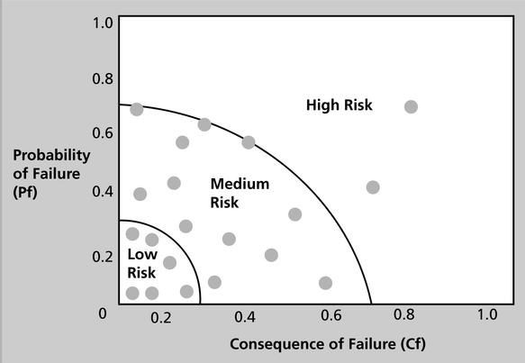
High-, Medium-, and Low-Risk Technologies
Example of how risk factors were used to graph the probability of failure and consequence of failure for proposed technologies in a research study to help design more reliable aircraft
Based on this chart, the recommendation was made to invest in low- to medium-risk technologies and not pursue high-risk technology

Slide 44
Top Ten Risk Item Tracking
Top Ten Risk Item Tracking is a qualitative risk analysis tool that helps to identify risks and maintain an awareness of risks throughout the life of a project
Establish a periodic review of the top ten project risk items
List the current ranking, previous ranking, number of times the risk appears on the list over a period of time, and a summary of progress made in resolving the risk item

Slide 45
Top Ten Risk Item Tracking
Keeps management and the customer aware of the major influences that could prevent or enhance the project’s success
By involving the customer, the project team may be able to consider alternative strategies for addressing the risks
It’s a means of promoting confidence in the project team by demonstrating to management and the customer that the team is aware of the significant risks, has a strategy in place and is effectively carrying out that strategy

Slide 46
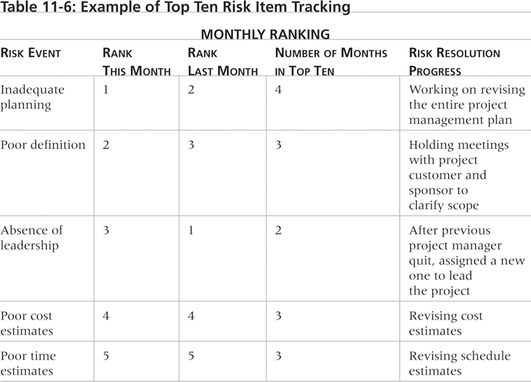
Example of Top Ten Risk Item Tracking

Slide 47
Watch List
A watch list is a list of risks that are low priority, but are still identified as potential risks
Qualitative analysis can also identify risks that should be evaluated on a quantitative basis

Slide 48
Quantitative Risk Analysis
Often follows qualitative risk analysis, but both can be done together
Large, complex projects involving leading edge technologies often require extensive quantitative risk analysis
Main techniques include:
Decision tree analysis
Simulation
Sensitivity analysis

Slide 49
Decision Trees and Expected Monetary Value (EMV)
A decision tree is a diagramming analysis technique used to help select the best course of action in situations in which future outcomes are uncertain
Estimated monetary value (EMV) is the product of a risk event probability and the risk event’s monetary value
You can draw a decision tree to help find the EMV

Slide 50
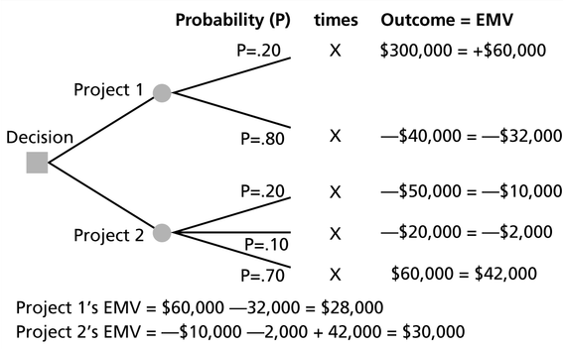
Expected Monetary Value (EMV)

Slide 51
Simulation
Simulation uses a representation or model of a system to analyze the expected behavior or performance of the system
To use a Monte Carlo simulation, you must have three estimates (most likely, pessimistic, and optimistic) plus an estimate of the likelihood of the estimate being between the most likely and optimistic values
Monte Carlo analysis simulates a model’s outcome many times to provide a statistical distribution of the calculated results
Predicts the probability of finishing by a certain date or that the cost will be equal to or less than a certain value

Slide 52
Steps of a Monte Carlo Analysis
Assess the range for the variables being considered – gather most likely, optimistic and pessimistic time estimates for each task
Determine the probability distribution of each variable
Optimistic 8 weeks, most likely 10 and pessimistic 15
For each variable, select a random value based on the probability distribution
20% chance between 8 and 10 weeks, 80% between 10 and 15
Run a deterministic analysis or one pass through the model
Repeat steps 3 and 4 many times to obtain the probability distribution of the model’s results – usually between 100 to 1,000 iterations

Slide 53
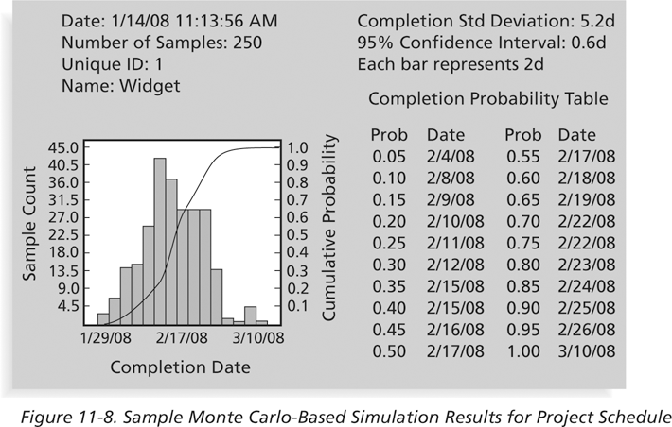
Sample Monte Carlo Simulation Results for Project Schedule

Slide 54
What Went Right?
A large aerospace company used Monte Carlo simulation to help quantify risks on several advanced-design engineering projects, such as the National Aerospace Plan (NASP)
Design a vehicle that could fly into space using a single-stage-to-orbit approach
The results of the simulation were used to determine how the company would invest its internal research and development funds
Although the NASP project was terminated, the resulting research has helped develop more advanced materials and propulsion systems used on many modern aircraft
Eli Lily uses simulation to determine the optimal plant capacity that should be built for each drug

Slide 55
Sensitivity Analysis
Sensitivity analysis is a technique used to show the effects of changing one or more variables on an outcome
For example, many people use it to determine what the monthly payments for a loan will be given different interest rates or periods of the loan, or for determining break-even points based on different assumptions
Spreadsheet software, such as Excel, is a common tool for performing sensitivity analysis

Slide 56
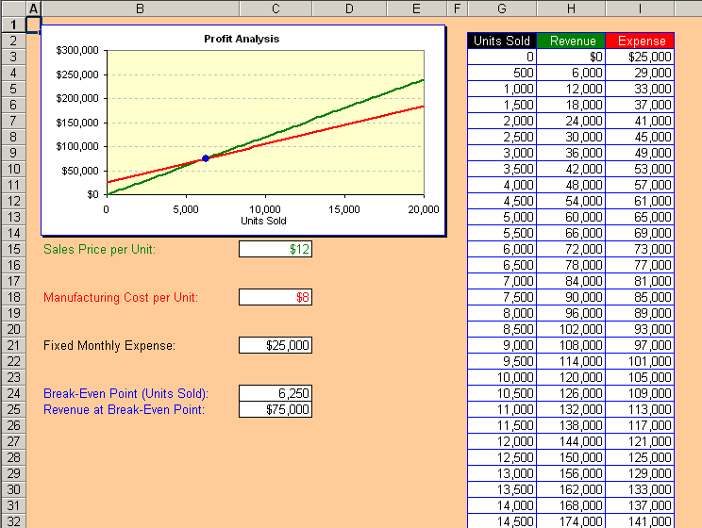
Sample Sensitivity Analysis for Determining Break-Even Point

Slide 57
Risk Response Planning
After identifying and quantifying risks, you must decide how to respond to them
Four main response strategies for negative risks:
Risk avoidance – don’t use h/w or s/w if unfamiliar with them
Risk acceptance – prepare for risk with backup plan or contingency reserves
Risk transference – to deal with financial risk exposure, a company may purchase special insurance for specific h/w needed for a project. If h/w fails, insurer has to replace it.
Risk mitigation – reduce probability of occurrence e.g., use proven technology, buy maintenance or service contract

Slide 58
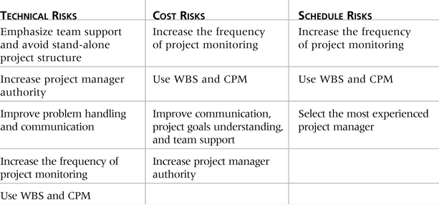
General Risk Mitigation Strategies for Technical, Cost, and Schedule Risks

Slide 59
Response Strategies for Positive Risks
Risk exploitation – do whatever you can to make sure the risk occurs, call press conference to advertise new product, take out ads, etc
Risk sharing – allocating ownership of the risk to another party. Hire an outside firm to do your advertising and PR
Risk enhancement – identify and maximize key drivers of the risk. Encourage your employees or users of your product to spread the word of your product
Risk acceptance – don’t take any action with regard to positive risk. Assume the product will speak for itself

Slide 60
Residual and Secondary Risks
It’s also important to identify residual and secondary risks
Residual risks are risks that remain after all of the response strategies have been implemented
Even though used stable h/w platform, it still may fail
Secondary risks are a direct result of implementing a risk response
Using stable h/w may have caused a risk of peripheral devices failing to function properly

Slide 61
Media Snapshot
A highly publicized example of a risk response to corporate financial scandals, such as those affecting Enron, Arthur Andersen, and WorldCom, was legal action
The Sarbanes-Oxley Act is considered the most significant change to federal securities laws in the United States since the New Deal
Fines, prison sentences up to 20 years for anyone who knowingly alters or destroys a record or document with the intent to obstruct an investigation
This Act has caused many organizations to initiate projects and other actions to avoid litigation

Slide 62
Risk Monitoring and Control
Involves executing the risk management process to respond to risk events
This is an ongoing activity – new risks identified, old risks disappear, weaken or get stronger
Workarounds are unplanned responses to risk events that must be done when there are no contingency plans
Main outputs of risk monitoring and control are:
Requested changes
Recommended corrective and preventive actions
Updates to the risk register, project management plan, and organizational process assets

Slide 63
Using Software to Assist in Project Risk Management
Risk registers can be created in a simple Word or Excel file or as part of a database
More sophisticated risk management software, such as Monte Carlo simulation tools, help in analyzing project risks
The PMI Risk Specific Interest Group’s Web site at www.risksig.com has a detailed list of software products to assist in risk management

Slide 64
Results of Good Project Risk Management
Unlike crisis management, good project risk management often goes unnoticed
Well-run projects appear to be almost effortless, but a lot of work goes into running a project well
Project managers should strive to make their jobs look easy to reflect the results of well-run projects

